Slide 1
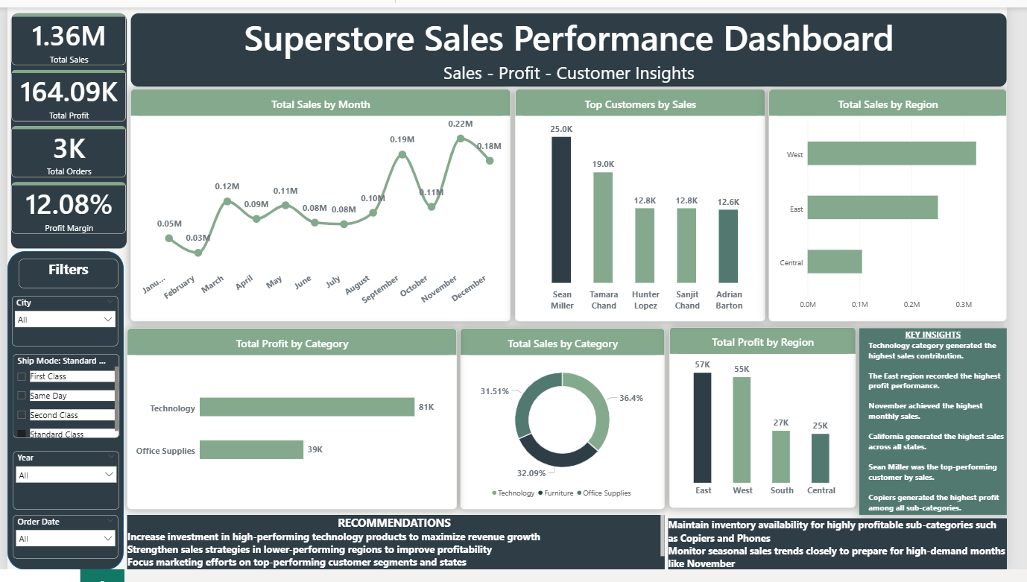
Superstore Sales Performance Dashboard
Sales – Profit – Customer Insights
Prepared by:
Precious Mmesoma Samuel
Data Visualization Internship Project
AnalystLab Africa
Tools Used:
Microsoft Power BI

Slide 2
DATASET OVERVIEW
Dataset:
Superstore Sales Dataset
Source:
Kaggle Superstore Dataset
Contains:
Sales transactions
Customer information
Product categories
Regions
Profits
Shipping details
Purpose:
To analyze business performance and identify trends, profitable categories, customer behavior, and sales opportunity.
Metric | Value
Rows | 9,994
Columns | 21
Time Period | 2014-2017

Slide 3
BUSINESS PROBLEM
The Superstore business generates a high volume of sales transactions across multiple product categories, customer segments, and regions. However, the company lacks a centralized and interactive system to effectively monitor performance, identify profitable areas, and detect underperforming products or regions. Without proper data visualization and analysis, decision-makers may struggle to: * Track monthly sales and profit trends * Identify top-performing customers and products * Understand regional sales performance * Detect low-profit or underperforming categories * Make informed, data-driven business decisions This project aims to transform raw sales data into an interactive dashboard that provides clear business insights, supports strategic decision-making, and improves overall business performance through data storytelling and visualization.

Slide 4
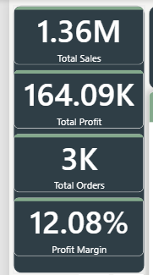
KPIs DEFINED
KPI | Meaning
Total Sales | Overall revenue generated
Total Profit | Net profit earned
Total Orders | Number of customer orders
Profit Margin | Profitability percentage

Slide 5
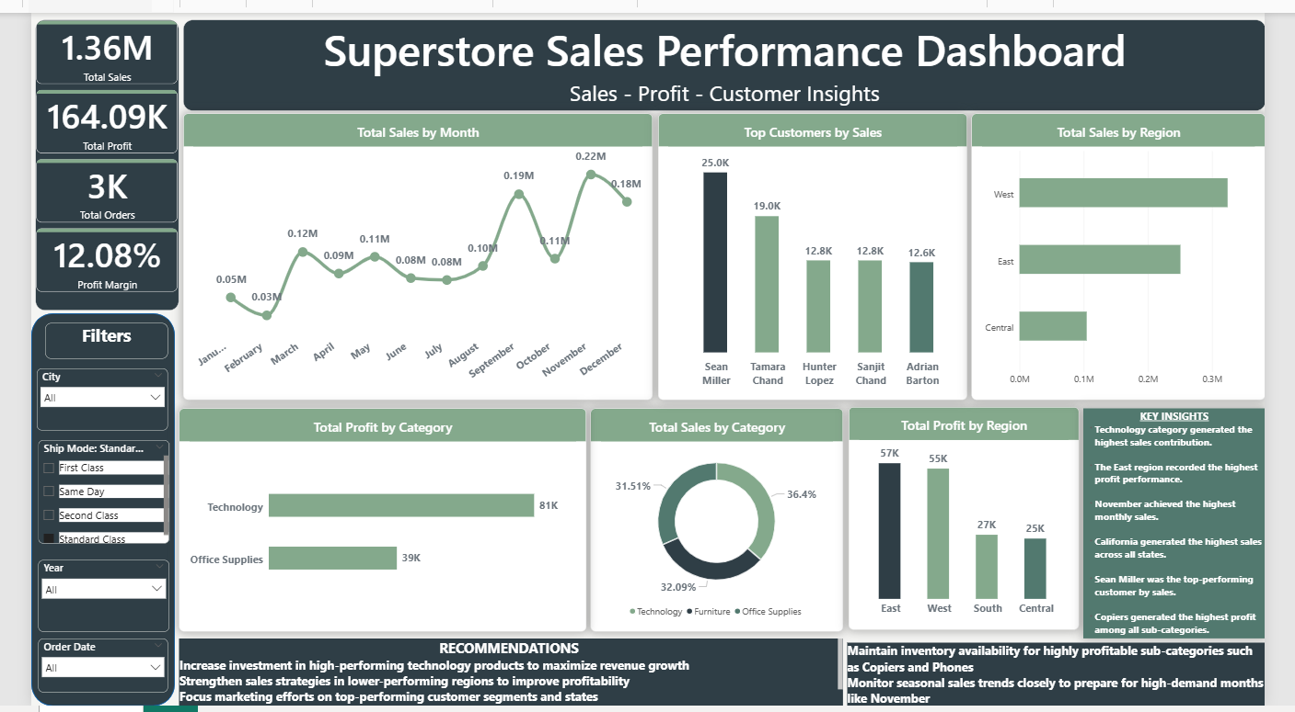
DASHBOARD OVERVIEW
The dashboard was designed to: monitor sales performance, analyze profitability, identify top customers, evaluate regional sales, track monthly trends.

Slide 6
KEY INSIGHTS
Technology category generated the highest sales contribution.
The East region recorded the highest profit performance.
November achieved the highest monthly sales.
California generated the highest sales across all states.
Sean Miller was the top-performing customer by sales.
Copiers generated the highest profit among all sub-categories.

Slide 7
RECOMMENDATIONS
Increase investment in high-performing technology products.
Improve sales strategies in lower-performing regions.
Maintain inventory availability for profitable products like Copiers and Phones.
Prepare for high-demand months through seasonal planning.
Strengthen customer retention strategies for top customer.

Slide 8
CHALLENGES FACED AND CONCLUSION
Challenges Faced:
Cleaning and organizing the dataset
Selecting the most appropriate visuals.
Maintaining a clean dashboard layout.
Ensuring visual consistency and readability.
Conclusion
The project successfully transformed raw sales data into a meaningful business insights through interactive visualizations and data storytelling. The dashboard helps stakeholders monitor performance, identify opportunities, and make data-driven decisions.

Slide 9
THANK YOU
https://github.com/Sampresh22
Samuel Precious | LinkedIn
preciousmmesoma56@gmail.com

